Slide 1
Enhancing copies in the Core of Relational Databases
July 20th, 2022

Slide 2
01 – Previous meeting wrap up
02 – Task completion
03 – Current status
04 – Next steps

Slide 3
01
Previous meeting wrap up

Slide 4
Previous meeting comments
Complete prove of convergence of the sequential copy process with weighted data
Experimental intuition

Slide 5
03
Current status

Slide 6
Current Status
01
Forgetting in the copy model
02
Custom loss function and train step functions

Slide 7
Forgetting in the copy model
The forgetting is defined as the decreasing of confidence the model has for each sample point.
Memory can be understanded as:
- Data points
- Compression of the data points into our model (weights)
Then, forgetting can be mitigated by using more data points (bad idea) or taking advantage of our previous steps learnings (weights).
The sequence of weights in our sequential construction must converge

Slide 8
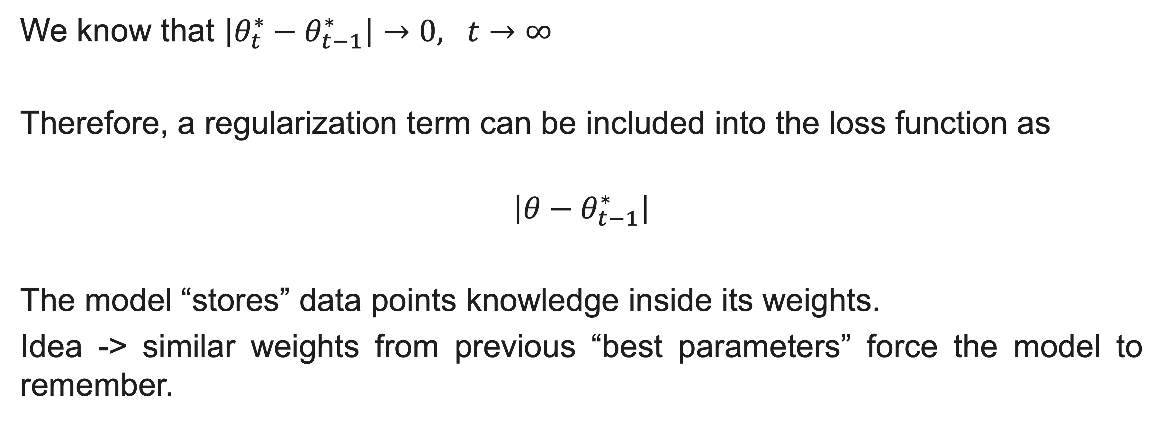
Forgetting in the copy model
We know that $\left|θ_{t}^{∗}−θ_{t−1}^{∗}\right|→0, t→∞$
Therefore, a regularization term can be included into the loss function as
$$\left|θ−θ_{t−1}^{∗}\right|$$
The model “stores” data points knowledge inside its weights.
Idea -> similar weights from previous “best parameters” force the model to remember.
This approach is still not working properly. TensorFlow issues

Slide 9
Current Status
01
Forgetting in the copy model
02
Custom loss and train step functions

Slide 10

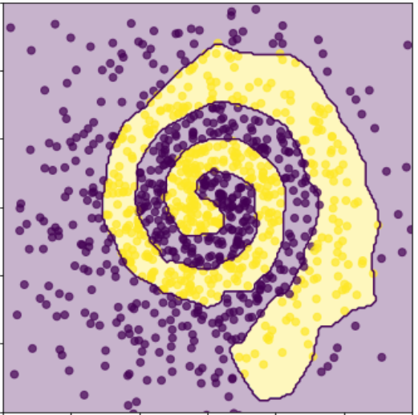
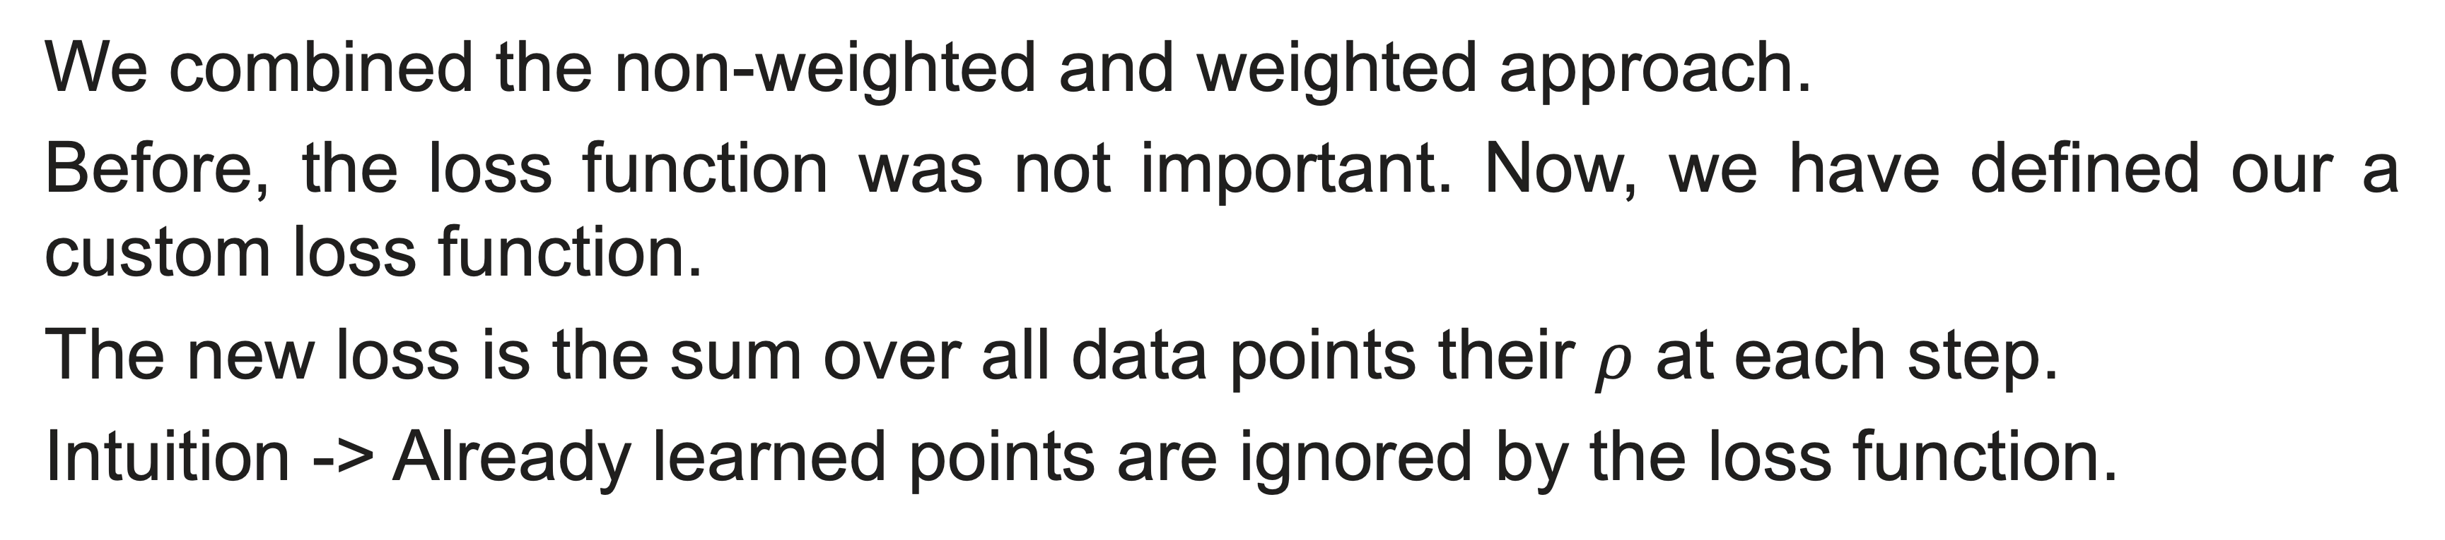
Custom loss and train step functions
We combined the non-weighted and weighted approach.
Before, the loss function was not important. Now, we have defined our a custom loss function.
The new loss is the sum over all data points their $ρ$ at each step.
Intuition -> Already learned points are ignored by the loss function.
The copy performs (at least) as well as it did before
N = 1000 -- One iteration

Slide 11
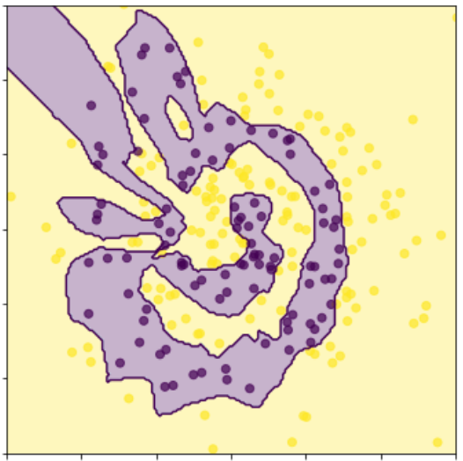
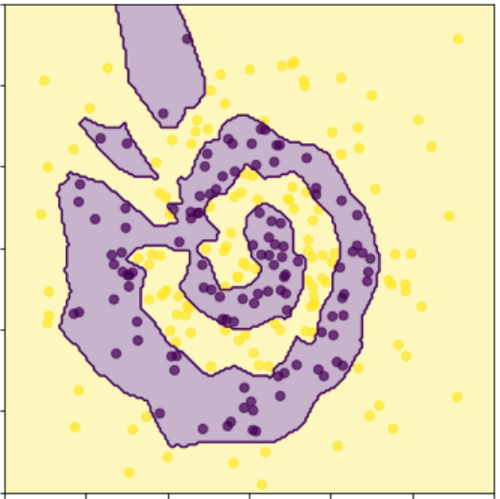
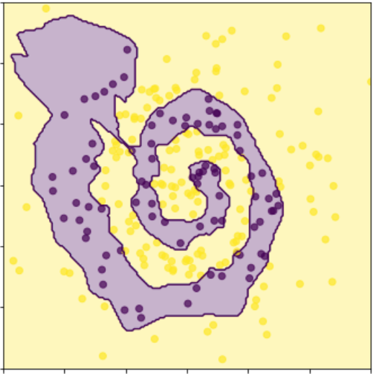
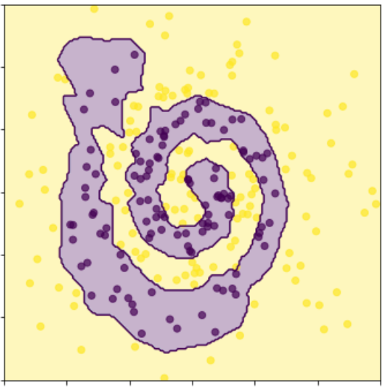
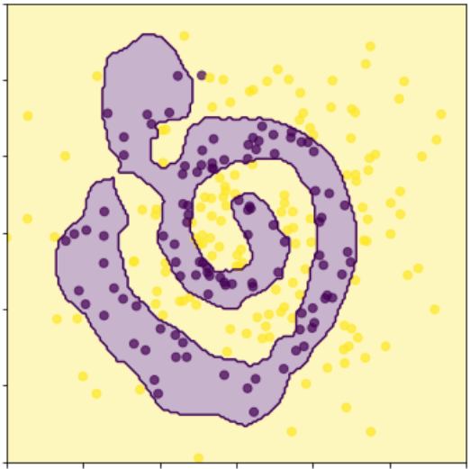
Custom loss and train step functions
t=0
t=1
t=2
t=3
t=8
Sequential learning with N=250 (at each iteration, without storing or deleting points)
Forgetting still happens. We will repeat this experiment once the regularization term works correctly.

Slide 12
04
Next Steps

Slide 13
Next Steps
01
Combine the new loss function with the regularization term and test its performance
02
Understand how forgetting behaves when the points instead of the memory compressed in the model
03
Write the paper. (Any news from the patent?)
04
Try real data

